Slide 1



Tempus IV Project «Ecological Education for Belarus, Russia and Ukraine» –
Еco-BRU
Olesia Skliarenko
PhD. As.Prof.

Slide 2
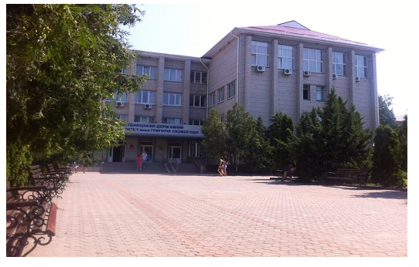
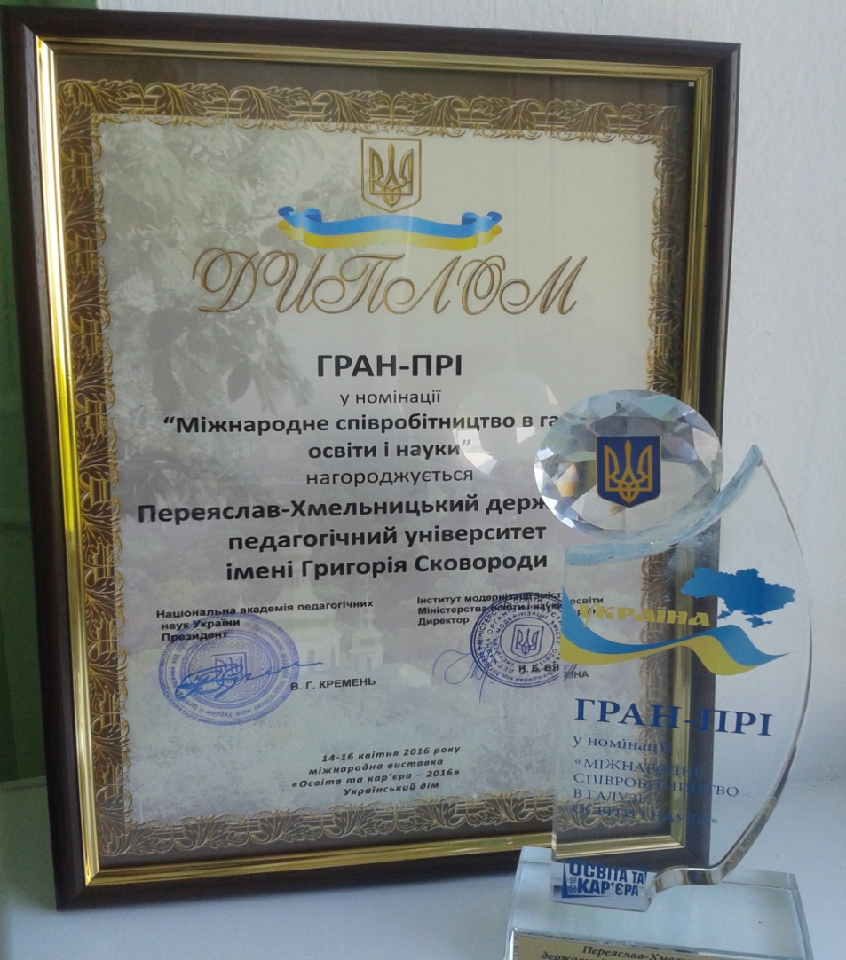

Slide 3
Continual ecological education for children
Infant school ecological familiarizing education | First steps of comprehension and awareness of ecological problems (1-4 classes) | Deepening of theoretical ecological knowledge, solving of educational and scientific problems; (5-11 classes)
Basics of extracurricular ecological work: goal-seeking pupils’ self-work activities in Ecology
Club «Tell me Why»
«Our Planet is our Earth»
Natural Science Lovers
Developed programs for increasing theoretical and methodological knowledge and business qualification for teachers and lecturers (they were approved at special seminar for project developers in
Pereyaslav-Khmelnytskyi at 29 . April 2015 ).

Slide 4
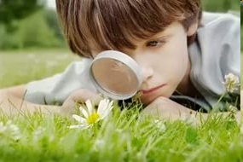
«Ecological Problems of Natural Science» for pupils of 1-4th. forms
Course Targets:
child’s development and strengthen of feelings of kindness and love to nature and to each other

Slide 5
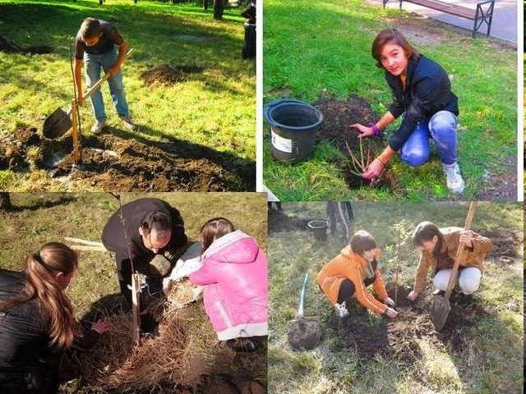
«System of Ecological Education For Senior Pupils»
( 5-9th. forms of secondary schools)
Course targets:
development of ecological culture of higher pupils, skills, fundamental ecological knowledge, ecological thinking and consciousness, which are based on careful attitude to the nature as a unique natural recourse.

Slide 6
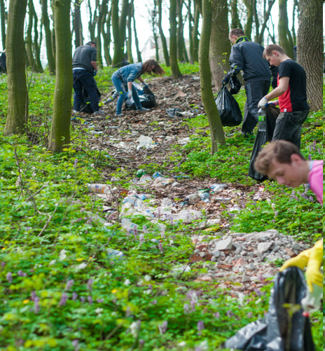
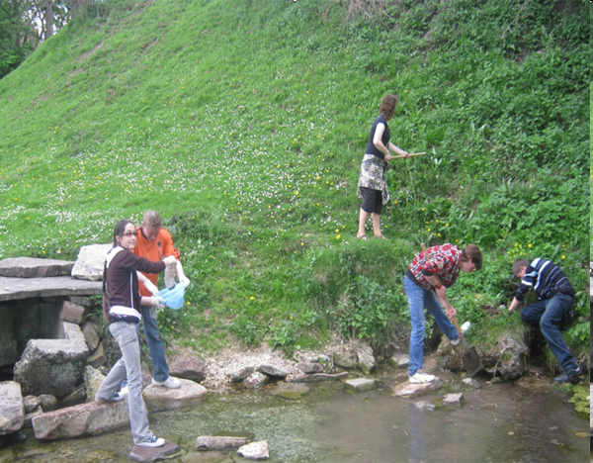
«Social and Ecological Problems of Natural Science» for pupils of 10-11th. forms of secondary schools
Course targets:
carrying out of complex analyses of ecological problems, reasons of their arisal, means of their solution, natural and antropogen factors of their influence on the person’s health.

Slide 7


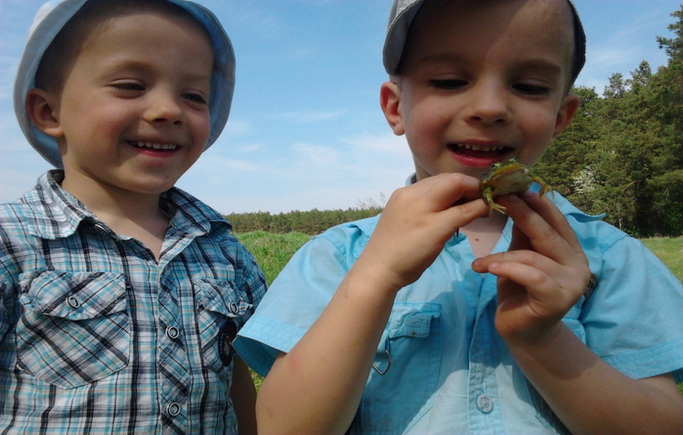
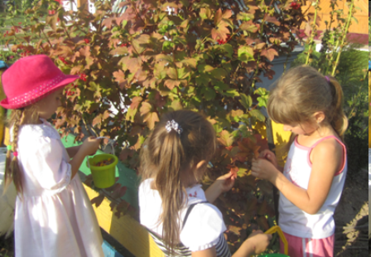
«I and the Surrounding World» for specialty
«Pre-school Education»
Course targets:
development of person’s ecological culture, who are professionally connected with education and children’s bringing up.

Slide 8
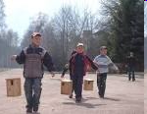
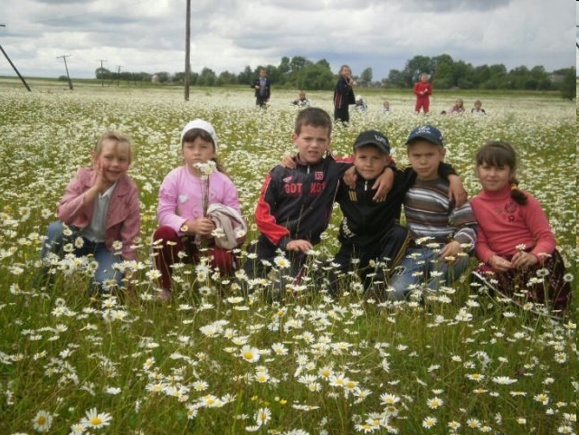
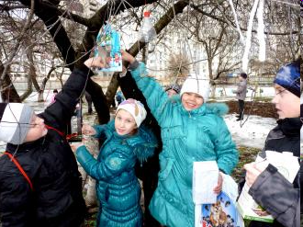
«Training Peculiarities of Ecological Education» for specialty «Primary Education»
Course target:
rules of interaction teaching of person’s world view to the nature and society as a part of nature.

Slide 9
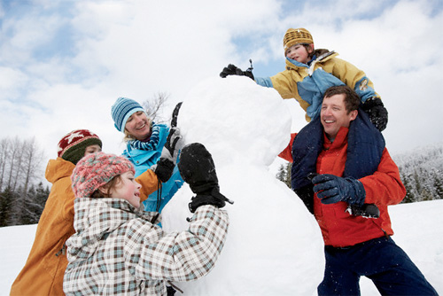
«Human Ecology: Biological and Social Aspects» for specialty «Occupational Safety and Health
Course target:
teaching of peculiarities of influences of ecological factors on the human’s body, changes in population health in connection with environment pollution, adaptation possibilities to the stress factor.

Slide 10


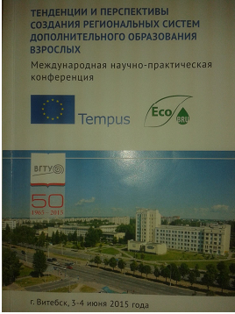

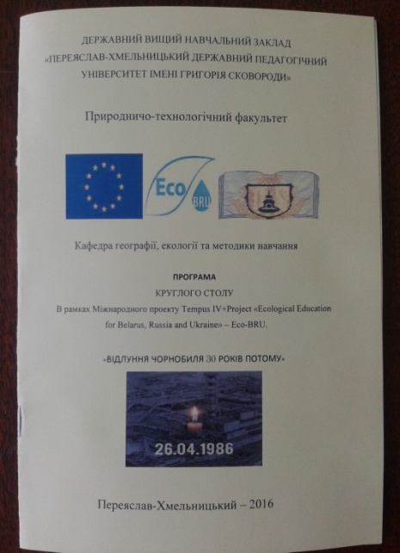


Published Results of «Eco BRU»

Slide 11




Our Collaboration:
Department for Education and Science of Kyiv Region State Administration;
Kyiv Regional Institute For Further Education of Pedagogical Staff;
National Ecological Centre for Pupils of the Ministry of Education and Science of Ukraine.

Slide 12

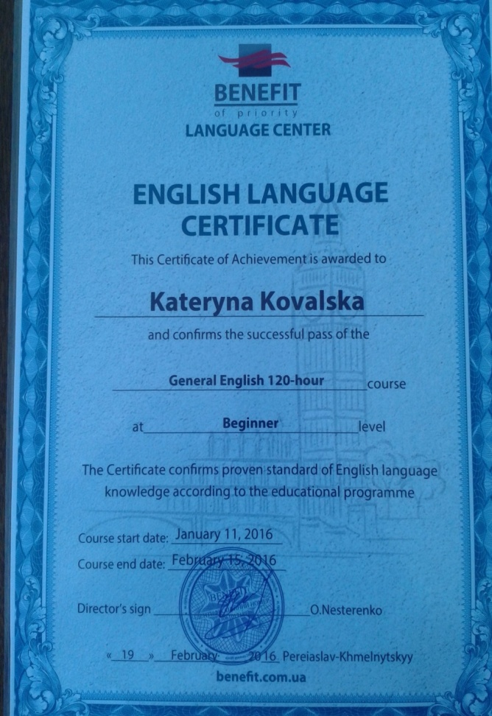
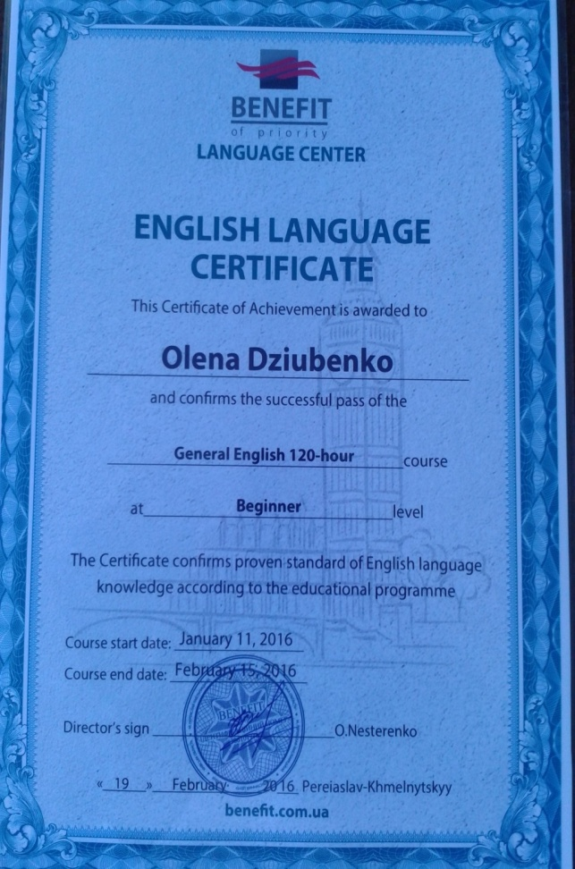
Language Courses

Slide 13
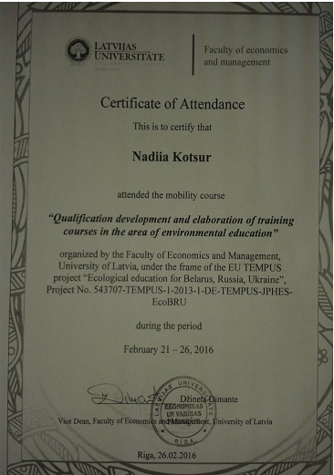
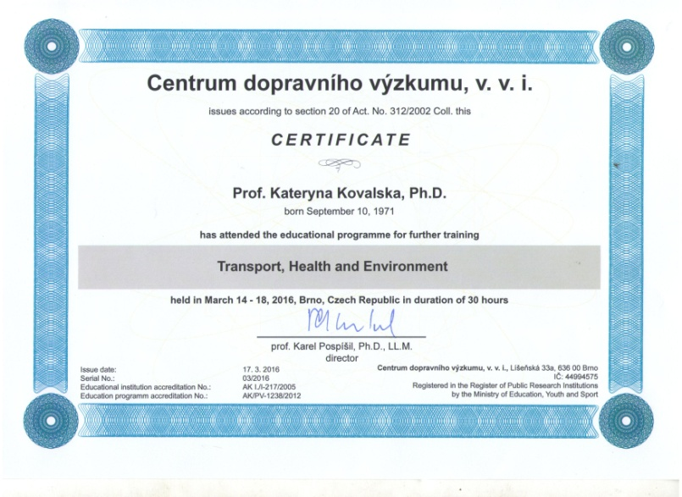
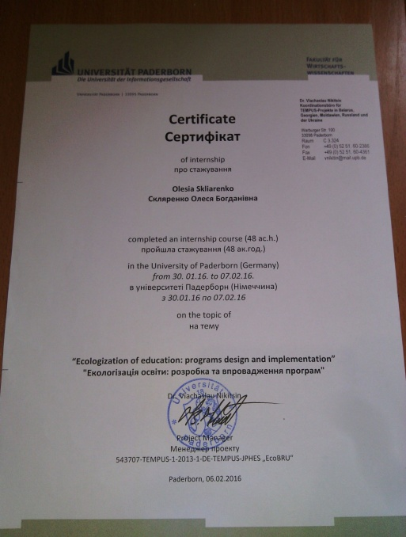
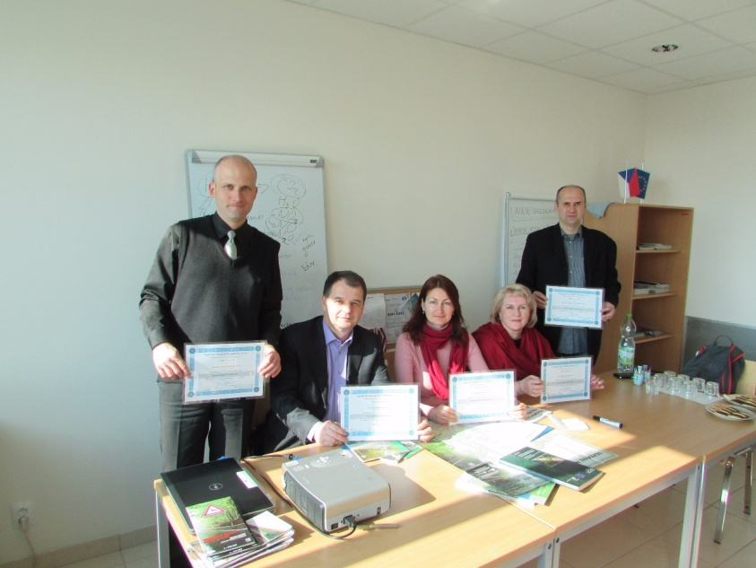
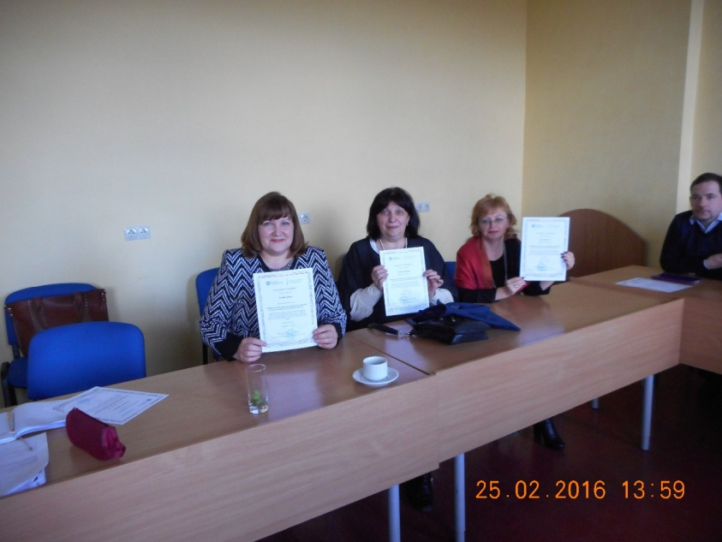
Training

Slide 14
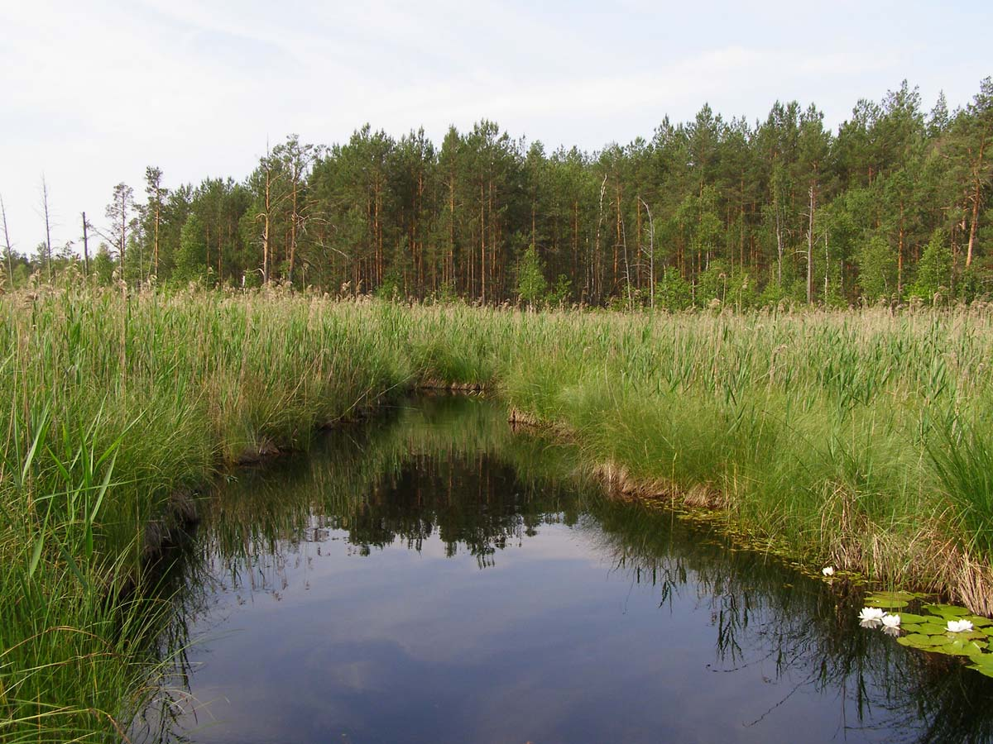
Дякую за увагу!
Thank you for your attention!

